Slide 1
OHDSI Tutorial: Patient-level predictive modelling in observational healthcare data
Faculty:
?
Egill Fridgeirsson (Erasmus)
Jenna Reps (Johnson & Johnson)

Slide 2
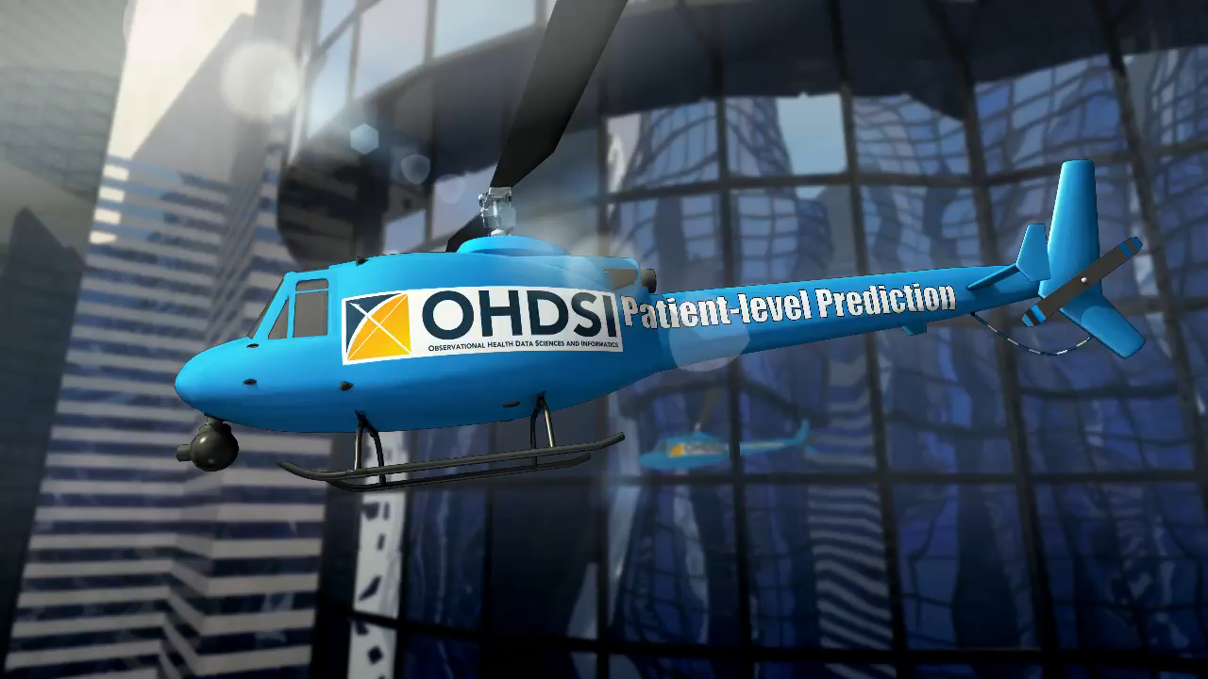
The journey toward Patient-Level Prediction

Slide 3
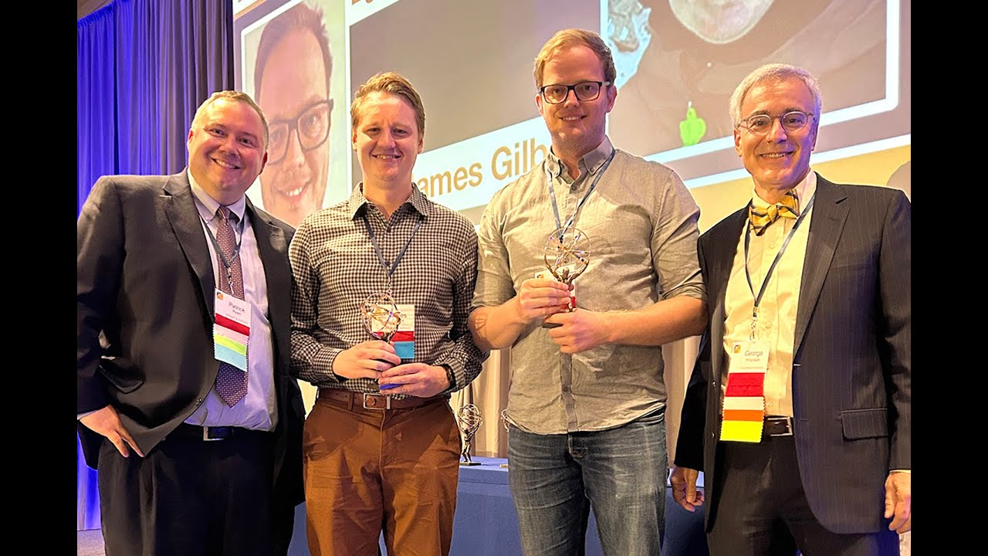
Faculty
Egill Fridgeirsson (Erasmus) |  | Jenna Reps (J&J)
Slides can be found on our Github:
https://github.com/OHDSI/Tutorial-PLP
https://www.ohdsi.org/who-we-are/collaborators/

Slide 4
Today’s Agenda
Time | Topic
12:45 - 13:00 | Get settled, get laptops ready
13:00 – 13:30 | Presentation: What is Patient-Level Prediction
13:30 – 13:45 | Exercise: Design your own prediction task
13:45 – 14:00 | Break
14:00 – 14:45 | Presentation: OHDSI Patient-Level Prediction With Best Practices (Jenna)
14:45 – 15:15 | Exercise: Design your own model
15:15 – 16:00 | Break
16:00 – 16:45 | Live demo: Using R to implement and explore a single or network study (Egill)
16:45 – 17:00 | Lessons Learned and Feedback

Slide 5
Welcome to the Patient-Level Prediction Tutorial
?

Slide 6
Kep Topics to cover in 30 mins
What is prediction vs other OHDSI analyses
Why is prediction important
The components of a prediction task – T/O/TAR
Example prediction tasks
Considerations – clinical utility/is there an intervention/is the outcome rare/can we phenotype

Slide 7
OHDSI’s Mission
To improve health, by empowering a community to collaboratively generate the evidence that promotes better health decisions and better care.
Hripcsak G, et al. (2015) Observational Health Data Sciences and Informatics (OHDSI): Opportunities for observational researchers. Stud Health Technol Inform 216:574–578.

Slide 8




A caricature of the patient journey
Disease
Treatment
Outcome
Conditions
Drugs
Procedures
Measurements
Person time
Baseline time
Follow-up time
0

Slide 9
Questions asked across the patient journey
Disease
Treatment
Outcome
Which treatment did patients choose after diagnosis?
Conditions
Which patients chose which treatments?
Does one treatment cause the outcome more than an alternative?
Drugs
Procedures
Measurements
How many patients experienced the outcome after treatment?
Does treatment cause outcome?
Person time
Baseline time
Follow-up time
What is the probability I will develop the disease?
0
What is the probability I will experience the outcome?

Slide 10
Complementary evidence to inform the patient journey
Clinical characterization:
What happened to them?
observation
Patient-level prediction:
What will happen to me?
Population-level effect estimation:
What are the causal effects?
inference
causal inference

Slide 11
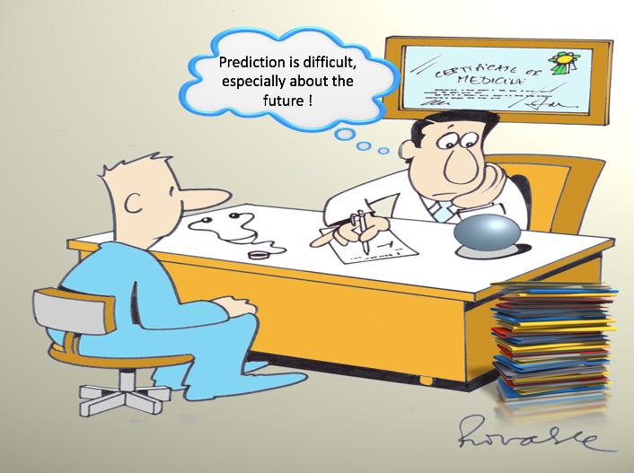
Clinicians are confronted with prediction questions on a daily basis. What options do they have?
Deny ability to predict at the individual patient level
Quote an overall average to all patients
Provide a personalized prediction based on an advanced clinical prediction model
Utilize knowledge and personal experience
Notes:
Doctors are asked to give predictions on a daily basis as shown in this cartoon of a atrial fibrillation patient with the question “What is my risk of stroke in the next year now I have Atrial fibrillation?”
What are the options a clinician has when confronted with a prediction question?
He could of course deny the ability to predict at the individual patient level and, although this is not the answer the patient wants to hear, this is sometimes to most sensible answer to give.
He could also quote an overall average to all patients with same age an gender, which is what Patrick has shown in his presentation about data characterization.
Often the doctor tries to give an answer based on his knowledge and experience with patients that have a comparable medical history as the patient in front of him.
This task is very difficult for a a human to fullfill because prediction is rarely based on a single factor but is a combination of multiple predictiors. The big question here is which are the predictors that need to be taken under consideration?
Ideally, he would have access to a prediction model that will predict the risk of this patient with all his medical history. This requires the development of an advanced patient-level prediction model.
As the great Danish physicist Niels Bohr said ”It is very difficult to predict, especially the future”. It is hard to know the current state you are in let alone what will happen to you in the future.
I think Bohr is right, it is a challenging task, but still I believe that in the data rich time we currently live and with the computer power we have for our modelling work, we are able to make big contributions to the field of patient-level predictive modelling.
This is the reason we have put patient-level predictive modeling high on the agenda of the OHDSI initiative and have created a patient-level prediction workgroup started lst year let by me and Jenna Reps.
We believe OHDSI is especially well equipped to move this field further because of the enormous energy that has been put in the standardization of data through the OMOP CDM and the vocabulary and the excellent multi-disciplinary expertise that is available.

Slide 12
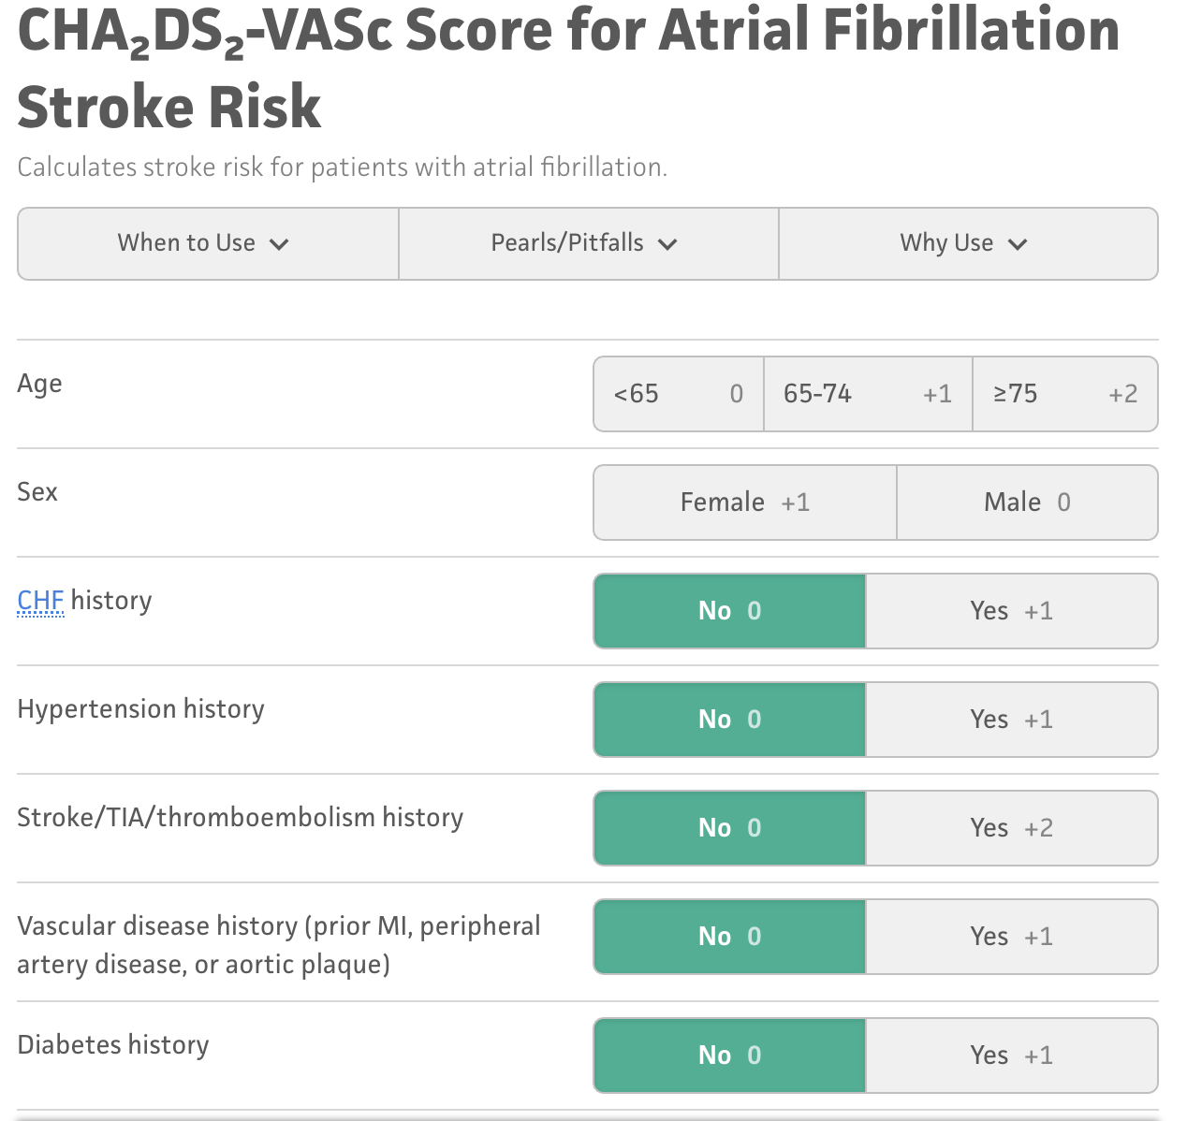
Example clinical prediction model
Amongst patients newly diagnosed with afib which patients will go on to have stroke within 1-year?

Slide 13
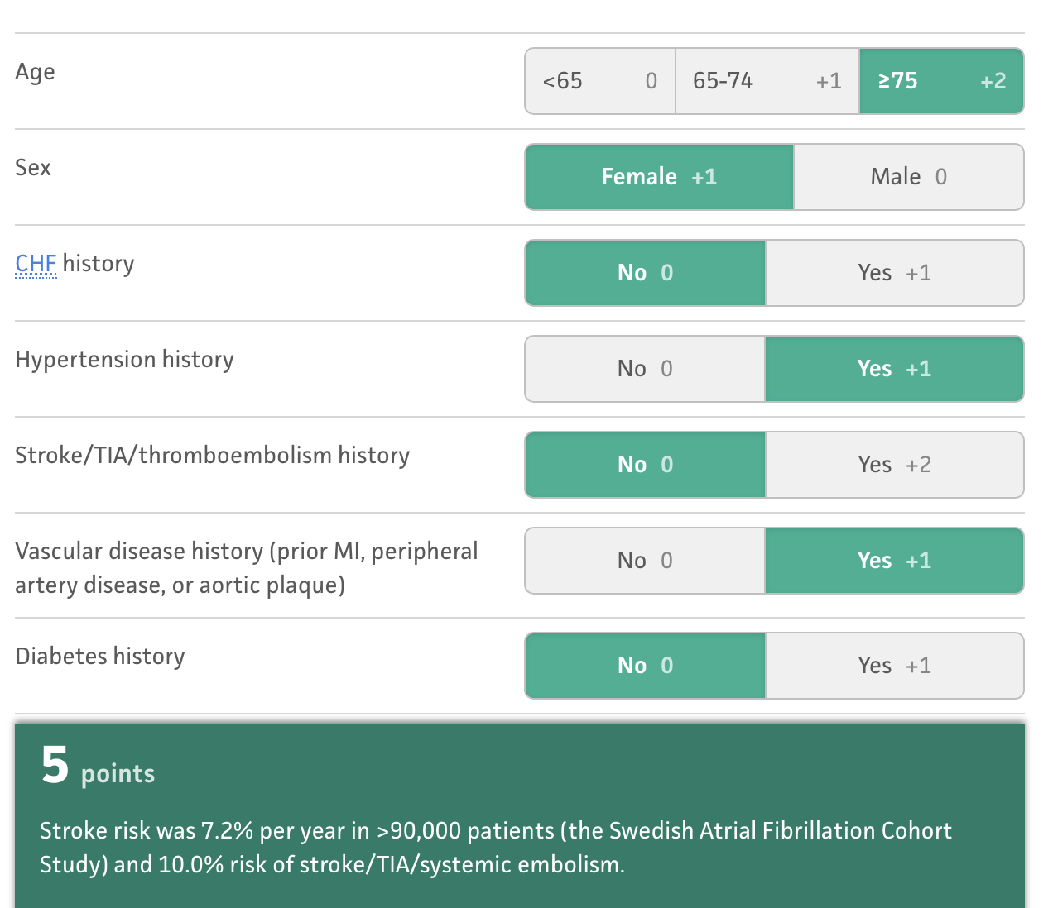
Example clinical prediction model
For a female Afib patient aged 78 with a history of hypertension and vascular disease, the patient’s risk of stroke is 7.2% in the next year.

Slide 14
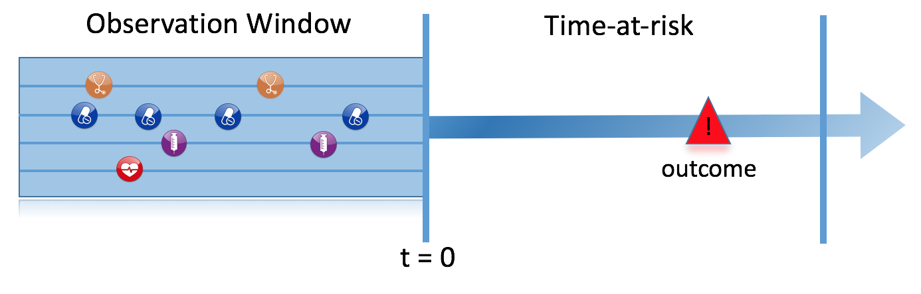
Prediction Problem Definition
Among a target population (T), we aim to predict which patients at a defined moment in time (t=0) will experience some outcome (O) during a time-at-risk Prediction is done using only information about the patients in an observation window prior to that moment in time.

Slide 15
What are the key inputs to a patient-level prediction study?
Input parameter | Design choice
Target cohort (T)
Outcome cohort (O)
Time-at-risk
Model development -which algorithm(s)? -which parameters? -which covariates?
We extract data for the patients in the Target Cohort (T) of which some will experience the outcome (O) in T
T
O

Slide 16
Types of prediction problems in healthcare
Type | Structure | Example
Disease onset and progression | Amongst patients who are newly diagnosed with <insert your favorite disease>, which patients will go on to have <another disease or related complication> within <time horizon from diagnosis>? | Among newly diagnosed AFib patients, which will go onto to have ischemic stroke in next 3 years?
Treatment choice | Amongst patients with <indicated disease> who are treated with either <treatment 1> or <treatment 2>, which patients were treated with <treatment 1> (on day 0)? | Among AFib patients who took either warfarin or rivaroxaban, which patients got warfarin? (as defined for propensity score model)
Treatment response | Amongst patients who are new users of <insert your favorite chronically-used drug>, which patients will <insert desired effect> in <time window>? | Which patients with T2DM who start on metformin stay on metformin after 3 years?
Treatment safety | Amongst patients who are new users of <insert your favorite drug>, which patients will experience <insert your favorite known adverse event from the drug profile> within <time horizon following exposure start>? | Among new users of warfarin, which patients will have GI bleed in 1 year?
Treatment adherence | Amongst patients who are new users of <insert your favorite chronically-used drug>, which patients will achieve <adherence metric threshold> at <time horizon>? | Which patients with T2DM who start on metformin achieve >=80% proportion of days covered at 1 year?

Slide 17
Types of prediction problems in healthcare
Type | Structure | Example
Disease onset and progression | Amongst patients who are newly diagnosed with <insert your favorite disease>, which patients will go on to have <another disease or related complication> within <time horizon from diagnosis>? | Among newly diagnosed AFib patients, which will go onto to have ischemic stroke in next 3 years?
Treatment choice | Amongst patients with <indicated disease> who are treated with either <treatment 1> or <treatment 2>, which patients were treated with <treatment 1> (on day 0)? | Among AFib patients who took either warfarin or rivaroxaban, which patients got warfarin? (as defined for propensity score model)
Treatment response | Amongst patients who are new users of <insert your favorite chronically-used drug>, which patients will <insert desired effect> in <time window>? | Which patients with T2DM who start on metformin stay on metformin after 3 years?
Treatment safety | Amongst patients who are new users of <insert your favorite drug>, which patients will experience <insert your favorite known adverse event from the drug profile> within <time horizon following exposure start>? | Among new users of warfarin, which patients will have GI bleed in 1 year?
Treatment adherence | Amongst patients who are new users of <insert your favorite chronically-used drug>, which patients will achieve <adherence metric threshold> at <time horizon>? | Which patients with T2DM who start on metformin achieve >=80% proportion of days covered at 1 year?
Type | Structure
Disease onset and progression | Amongst patients who are newly diagnosed with <insert your favorite disease>, which patients will go on to have <another disease or related complication> within <time horizon from diagnosis>? Among newly diagnosed AFib patients, which will go onto to have ischemic stroke in next 3 years?

Slide 18
Types of prediction problems in healthcare
Type | Structure | Example
Disease onset and progression | Amongst patients who are newly diagnosed with <insert your favorite disease>, which patients will go on to have <another disease or related complication> within <time horizon from diagnosis>? | Among newly diagnosed AFib patients, which will go onto to have ischemic stroke in next 3 years?
Treatment choice | Amongst patients with <indicated disease> who are treated with either <treatment 1> or <treatment 2>, which patients were treated with <treatment 1> (on day 0)? | Among AFib patients who took either warfarin or rivaroxaban, which patients got warfarin? (as defined for propensity score model)
Treatment response | Amongst patients who are new users of <insert your favorite chronically-used drug>, which patients will <insert desired effect> in <time window>? | Which patients with T2DM who start on metformin stay on metformin after 3 years?
Treatment safety | Amongst patients who are new users of <insert your favorite drug>, which patients will experience <insert your favorite known adverse event from the drug profile> within <time horizon following exposure start>? | Among new users of warfarin, which patients will have GI bleed in 1 year?
Treatment adherence | Amongst patients who are new users of <insert your favorite chronically-used drug>, which patients will achieve <adherence metric threshold> at <time horizon>? | Which patients with T2DM who start on metformin achieve >=80% proportion of days covered at 1 year?
Type | Structure
Treatment choice | Amongst patients with <indicated disease> who are treated with either <treatment 1> or <treatment 2>, which patients were treated with <treatment 1> (on day 0)? Among AFib patients who took either warfarin or rivaroxaban, which patients got warfarin? (as defined for propensity score model)

Slide 19
Types of prediction problems in healthcare
Type | Structure | Example
Disease onset and progression | Amongst patients who are newly diagnosed with <insert your favorite disease>, which patients will go on to have <another disease or related complication> within <time horizon from diagnosis>? | Among newly diagnosed AFib patients, which will go onto to have ischemic stroke in next 3 years?
Treatment choice | Amongst patients with <indicated disease> who are treated with either <treatment 1> or <treatment 2>, which patients were treated with <treatment 1> (on day 0)? | Among AFib patients who took either warfarin or rivaroxaban, which patients got warfarin? (as defined for propensity score model)
Treatment response | Amongst patients who are new users of <insert your favorite chronically-used drug>, which patients will <insert desired effect> in <time window>? | Which patients with T2DM who start on metformin stay on metformin after 3 years?
Treatment safety | Amongst patients who are new users of <insert your favorite drug>, which patients will experience <insert your favorite known adverse event from the drug profile> within <time horizon following exposure start>? | Among new users of warfarin, which patients will have GI bleed in 1 year?
Treatment adherence | Amongst patients who are new users of <insert your favorite chronically-used drug>, which patients will achieve <adherence metric threshold> at <time horizon>? | Which patients with T2DM who start on metformin achieve >=80% proportion of days covered at 1 year?
Type | Structure
Treatment response | Amongst patients who are new users of <insert your favorite chronically-used drug>, which patients will <insert desired effect> in <time window>? Which patients with T2DM who start on metformin stay on metformin after 3 years?

Slide 20
Types of prediction problems in healthcare
Type | Structure | Example
Disease onset and progression | Amongst patients who are newly diagnosed with <insert your favorite disease>, which patients will go on to have <another disease or related complication> within <time horizon from diagnosis>? | Among newly diagnosed AFib patients, which will go onto to have ischemic stroke in next 3 years?
Treatment choice | Amongst patients with <indicated disease> who are treated with either <treatment 1> or <treatment 2>, which patients were treated with <treatment 1> (on day 0)? | Among AFib patients who took either warfarin or rivaroxaban, which patients got warfarin? (as defined for propensity score model)
Treatment response | Amongst patients who are new users of <insert your favorite chronically-used drug>, which patients will <insert desired effect> in <time window>? | Which patients with T2DM who start on metformin stay on metformin after 3 years?
Treatment safety | Amongst patients who are new users of <insert your favorite drug>, which patients will experience <insert your favorite known adverse event from the drug profile> within <time horizon following exposure start>? | Among new users of warfarin, which patients will have GI bleed in 1 year?
Treatment adherence | Amongst patients who are new users of <insert your favorite chronically-used drug>, which patients will achieve <adherence metric threshold> at <time horizon>? | Which patients with T2DM who start on metformin achieve >=80% proportion of days covered at 1 year?
Type | Structure
Treatment safety | Amongst patients who are new users of <insert your favorite drug>, which patients will experience <insert your favorite known adverse event from the drug profile> within <time horizon following exposure start>? Among new users of warfarin, which patients will have GI bleed in 1 year?

Slide 21
Types of prediction problems in healthcare
Type | Structure | Example
Disease onset and progression | Amongst patients who are newly diagnosed with <insert your favorite disease>, which patients will go on to have <another disease or related complication> within <time horizon from diagnosis>? | Among newly diagnosed AFib patients, which will go onto to have ischemic stroke in next 3 years?
Treatment choice | Amongst patients with <indicated disease> who are treated with either <treatment 1> or <treatment 2>, which patients were treated with <treatment 1> (on day 0)? | Among AFib patients who took either warfarin or rivaroxaban, which patients got warfarin? (as defined for propensity score model)
Treatment response | Amongst patients who are new users of <insert your favorite chronically-used drug>, which patients will <insert desired effect> in <time window>? | Which patients with T2DM who start on metformin stay on metformin after 3 years?
Treatment safety | Amongst patients who are new users of <insert your favorite drug>, which patients will experience <insert your favorite known adverse event from the drug profile> within <time horizon following exposure start>? | Among new users of warfarin, which patients will have GI bleed in 1 year?
Treatment adherence | Amongst patients who are new users of <insert your favorite chronically-used drug>, which patients will achieve <adherence metric threshold> at <time horizon>? | Which patients with T2DM who start on metformin achieve >=80% proportion of days covered at 1 year?
Type | Structure
Treatment adherence | Amongst patients who are new users of <insert your favorite chronically-used drug>, which patients will achieve <adherence metric threshold> at <time horizon>? Which patients with T2DM who start on metformin achieve >=80% proportion of days covered at 1 year?

Slide 22
How to pick a clinically useful task?
Think about:
Is there a current medical decision you find difficult?
Is there a clear point in time you can apply a prediction model to help with the decision? (e.g., visit when first diagnosed)
Is the target and outcome recorded in our OHDSI data?
How common is the outcome? If you could identify a group of patients with 10x the population average risk would that help?

Slide 23
Types of prediction problems in healthcare
Type | Structure | Example
Disease onset and progression | Amongst patients who are newly diagnosed with <insert your favorite disease>, which patients will go on to have <another disease or related complication> within <time horizon from diagnosis>? | Among newly diagnosed AFib patients, which will go onto to have ischemic stroke in next 3 years?
Treatment choice | Amongst patients with <indicated disease> who are treated with either <treatment 1> or <treatment 2>, which patients were treated with <treatment 1> (on day 0)? | Among AFib patients who took either warfarin or rivaroxaban, which patients got warfarin? (as defined for propensity score model)
Treatment response | Amongst patients who are new users of <insert your favorite chronically-used drug>, which patients will <insert desired effect> in <time window>? | Which patients with T2DM who start on metformin stay on metformin after 3 years?
Treatment safety | Amongst patients who are new users of <insert your favorite drug>, which patients will experience <insert your favorite known adverse event from the drug profile> within <time horizon following exposure start>? | Among new users of warfarin, which patients will have GI bleed in 1 year?
Treatment adherence | Amongst patients who are new users of <insert your favorite chronically-used drug>, which patients will achieve <adherence metric threshold> at <time horizon>? | Which patients with T2DM who start on metformin achieve >=80% proportion of days covered at 1 year?

Slide 25
Today’s Agenda
Time | Topic
12:45 - 13:00 | Get settled, get laptops ready
13:00 – 13:30 | Presentation: What is Patient-Level Prediction
13:30 – 13:45 | Exercise: Design your own prediction task
13:45 – 14:00 | Break
14:00 – 14:45 | Presentation: OHDSI Patient-Level Prediction With Best Practices
14:45 – 15:15 | Exercise: Design your own model
15:15 – 16:00 | Break
16:00 – 16:30 | Presentation: Using R to implement your design and run a network study
16:30 – 16:45 | Demo: Exploring a network study results
16:45 – 17:00 | Lessons Learned and Feedback

Slide 26
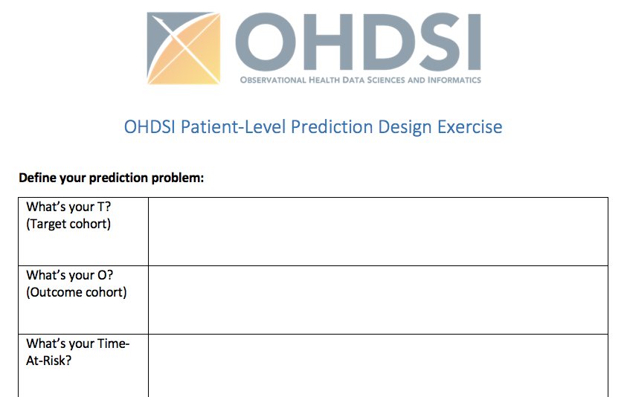
What is your prediction problem?
Fill in your form in small groups (15 min)
Think about:
Will these patients be identifiable in the data?
Is there a medical question this can aid?
Is there an intervention this can help?

Slide 27
Today’s Agenda
Time | Topic
12:45 - 13:00 | Get settled, get laptops ready
13:00 – 13:30 | Presentation: What is Patient-Level Prediction
13:30 – 13:45 | Exercise: Design your own prediction task
13:45 – 14:00 | Break
14:00 – 14:45 | Presentation: OHDSI Patient-Level Prediction With Best Practices
14:45 – 15:15 | Exercise: Design your own model
15:15 – 16:00 | Break
16:00 – 16:30 | Presentation: Using R to implement your design and run a network study
16:30 – 16:45 | Demo: Exploring a network study results
16:45 – 17:00 | Lessons Learned and Feedback

Slide 28

Let’s take a 15 min break
Be back by 2pm

Slide 29
Today’s Agenda
Time | Topic
12:45 - 13:00 | Get settled, get laptops ready
13:00 – 13:30 | Presentation: What is Patient-Level Prediction
13:30 – 13:45 | Exercise: Design your own prediction task
13:45 – 14:00 | Break
14:00 – 14:45 | Presentation: OHDSI Patient-Level Prediction With Best Practices
14:45 – 15:15 | Exercise: Design your own model
15:15 – 16:00 | Break
16:00 – 16:30 | Presentation: Using R to implement your design and run a network study
16:30 – 16:45 | Demo: Exploring a network study results
16:45 – 17:00 | Lessons Learned and Feedback

Slide 30
OHDSI PLP Framework with Best Practices
Jenna Reps

Slide 31
Things to cover in 45 mins
Extracting the data (cohort vs case control, features, etc)
Learning the model (hyperparams, split, classifier choice, etc)
OHDSI PLP model design components
Evaluating the model (AUROC, calibration, …)

Slide 32
The Framework

Slide 33
Cohort vs case-control design

Slide 34
Extracting labelled data

Slide 35
Retrospective cohort design using RWD for prediction
We find people in the data who historically match our target population and we follow them for the time-at-risk to see whether they had the outcome or not.
Example: one patient who had the outcome

Slide 36
Developing the model

Slide 37
Evaluating the model

Slide 38
Publishing the model
TRIPOD

Slide 39


Questions?

Slide 40
Today’s Agenda
Time | Topic
12:45 - 13:00 | Get settled, get laptops ready
13:00 – 13:30 | Presentation: What is Patient-Level Prediction
13:30 – 13:45 | Exercise: Design your own prediction task
13:45 – 14:00 | Break
14:00 – 14:45 | Presentation: OHDSI Patient-Level Prediction With Best Practices
14:45 – 15:15 | Exercise: Design your own model
15:15 – 16:00 | Break
16:00 – 16:30 | Presentation: Using R to implement your design and run a network study
16:30 – 16:45 | Demo: Exploring a network study results
16:45 – 17:00 | Lessons Learned and Feedback

Slide 41
Design your model
Pick your features
Pick feature engineering
Pick sample settings
Pick a classifier (or set of classifiers)
Pick your data split settings

Slide 42
Today’s Agenda
Time | Topic
12:45 - 13:00 | Get settled, get laptops ready
13:00 – 13:30 | Presentation: What is Patient-Level Prediction
13:30 – 13:45 | Exercise: Design your own prediction task
13:45 – 14:00 | Break
14:00 – 14:45 | Presentation: OHDSI Patient-Level Prediction With Best Practices
14:45 – 15:15 | Exercise: Design your own model
15:15 – 16:00 | Break
16:00 – 16:30 | Presentation: Using R to implement your design and run a network study
16:30 – 16:45 | Demo: Exploring a network study results
16:45 – 17:00 | Lessons Learned and Feedback

Slide 43
Let’s take a 15 min break
Be back by 4pm

Slide 44
Today’s Agenda
Time | Topic
12:45 - 13:00 | Get settled, get laptops ready
13:00 – 13:30 | Presentation: What is Patient-Level Prediction
13:30 – 13:45 | Exercise: Design your own prediction task
13:45 – 14:00 | Break
14:00 – 14:45 | Presentation: OHDSI Patient-Level Prediction With Best Practices
14:45 – 15:15 | Exercise: Design your own model
15:15 – 16:00 | Break
16:00 – 16:30 | Presentation: Using R to implement your design and run a network study
16:30 – 16:45 | Demo: Exploring study results via shiny
16:45 – 17:00 | Lessons Learned and Feedback

Slide 45
Live Demo Developing models using the PatientLevelPrediction R package
Egill Fridgeirsson

Slide 46
Move over to markdown html
Add link here

Slide 47
Today’s Agenda
Time | Topic
12:45 - 13:00 | Get settled, get laptops ready
13:00 – 13:30 | Presentation: What is Patient-Level Prediction
13:30 – 13:45 | Exercise: Design your own prediction task
13:45 – 14:00 | Break
14:00 – 14:45 | Presentation: OHDSI Patient-Level Prediction With Best Practices
14:45 – 15:15 | Exercise: Design your own model
15:15 – 16:00 | Break
16:00 – 16:30 | Presentation: Using R to implement your design and run a network study
16:30 – 16:45 | Demo: Exploring study results via shiny
16:45 – 17:00 | Lessons Learned and Feedback

Slide 48
Lessons learned and feedback

Slide 49
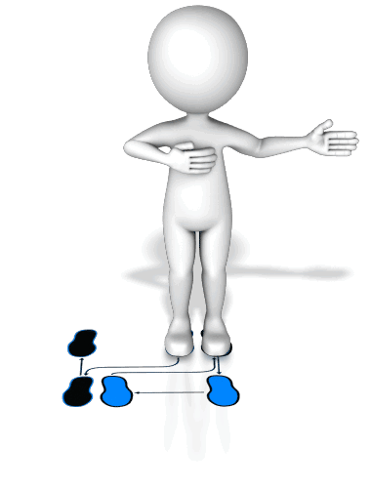

Lessons Learned
Learned the PLP Dance
Educated Fortune Teller

Slide 50
What’s Next?
Do you still think your prediction task can help? If so, write a network study for your model and get the community to build it. If not, can you think of a different task?
R-package
www.github.com/OHDSI/PatientLevelPrediction
Vignettes
Videos
Online training material
Book-of-OHDSI https://ohdsi.github.io/TheBookOfOhdsi/
Study Results
www.data.ohdsi.org

Slide 51

Join the PLP Community
Monthly meetings of PLP WG
Researchers Forum
(tag patientprediction)
Become an active developer: add your own algorithms and other features

Slide 52


Continuation of the PLP Journey
Scale up
Increase the number of database
Increase the number of cohorts at risk
Increase the number of outcomes
Method Research
Performance
Transportability
Temporal information
Textual information
Deep learning
Ensemble training
Learning Curves
Clinical impact for the patient
How to assess?
Tool Development
Model Library
Results viewer improvements.

Slide 53
Tutorial improvement
We like to hear your feedback on this course:
What went well?
What did not?
What do you like to see added?
You can give your feedback on the evaluation form:
https://bit.ly/2EeSIpC

Slide 54


Questions? Drop us an email
jreps@its.jnj.com
Notes:
I like to keep these two slides in, they will not take time.

